Slide 1
Chapter 7 Interactions
© 2015 Pearson Education, Inc.

Slide 2
Chapter 7: Interactions
Chapter Goal: To investigate how interactions convert energy from one form to another in physical processes within the universe.
© 2015 Pearson Education, Inc.

Slide 3
Chapter 7 Preview
Looking Ahead: The basics of interactions
An interaction is an event that produces either a change in physical state or a change in motion.
You learned that the four fundamental interactions in our universe are gravitational, electromagnetic, weak nuclear, and strong nuclear.
© 2015 Pearson Education, Inc.

Slide 4
Chapter 7 Preview
Looking Ahead: Potential energy
Potential energy is a coherent form of internal energy associated with the reversible changes in the configuration of an object or system.
You will learn about the potential energy associated with gravitational and elastic interactions.
© 2015 Pearson Education, Inc.

Slide 5
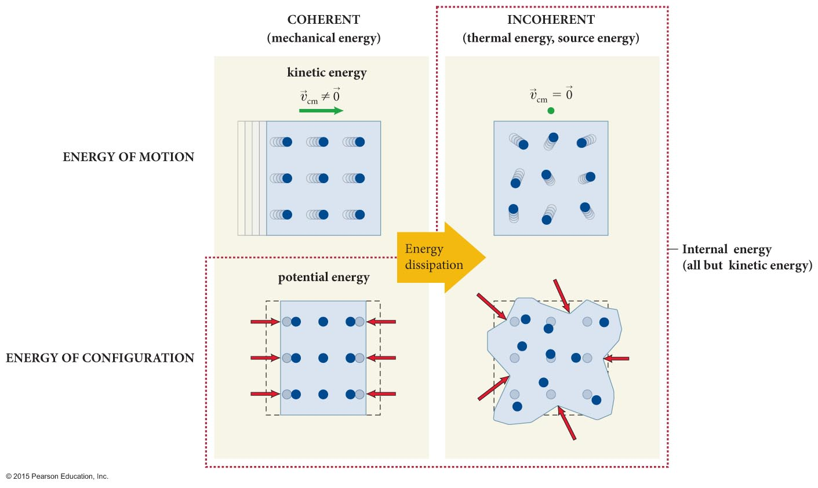
Chapter 7 Preview
Looking Ahead: Energy dissipation during interactions
Dissipative interactions are irreversible interactions that involve changes in thermal energy.
You will learn to mathematically account for the types of energy in dissipative and nondissipative interactions.
© 2015 Pearson Education, Inc.

Slide 6
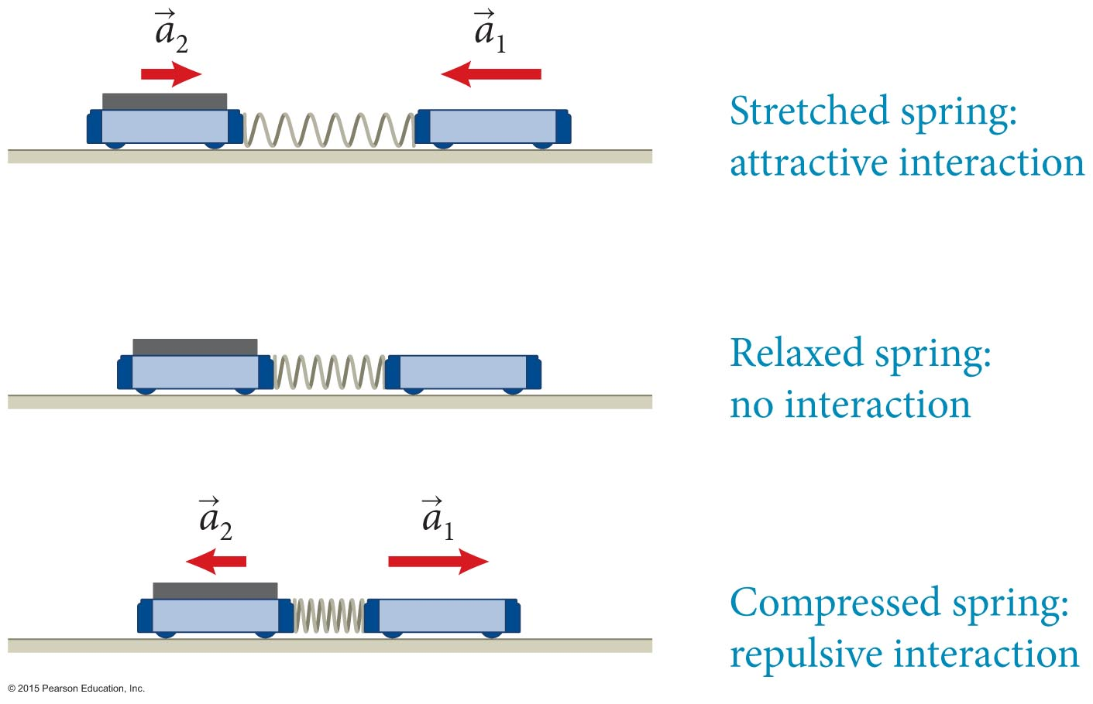
Section 7.1: The effects of interactions
Interactions are mutual influences between two objects that produce change, either change in motion or physical change.
The figure below shows an interaction between two carts linked by a spring.
© 2015 Pearson Education, Inc.

Slide 7
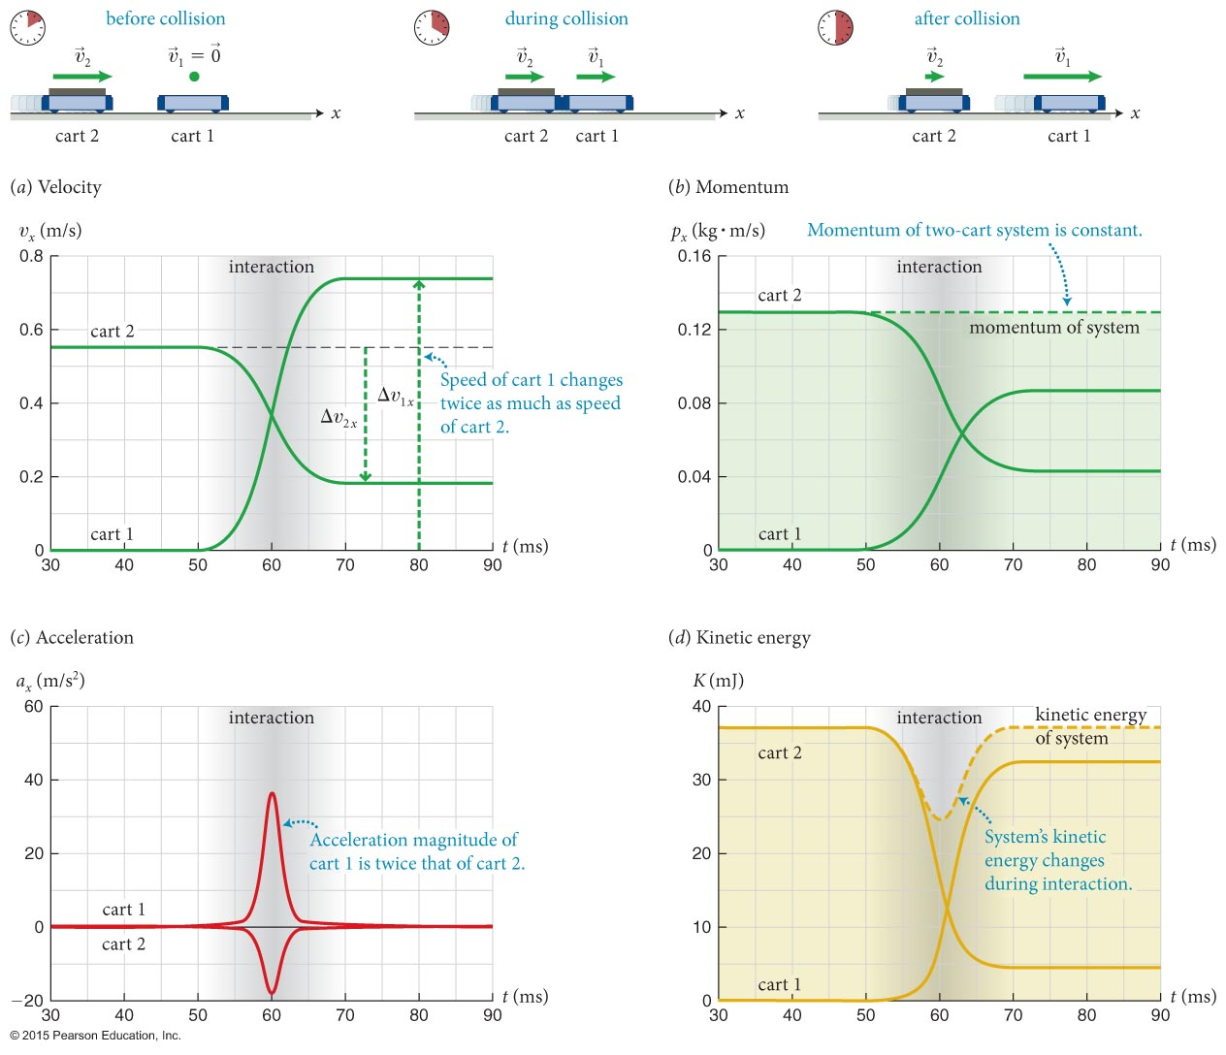
Section 7.1: The effects of interactions
© 2015 Pearson Education, Inc.

Slide 8
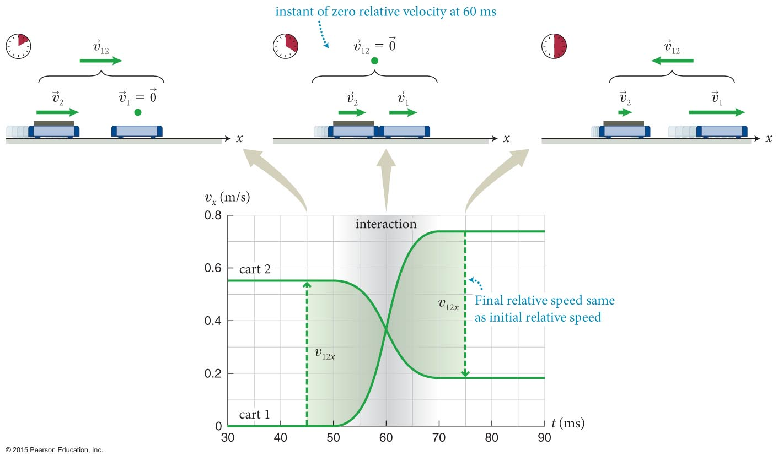
Section 7.1: The effects of interactions
The figure below shows that whenever two objects interact, their relative speeds have to change, and therefore the kinetic energy of the system must also change during the interaction.
© 2015 Pearson Education, Inc.

Slide 9
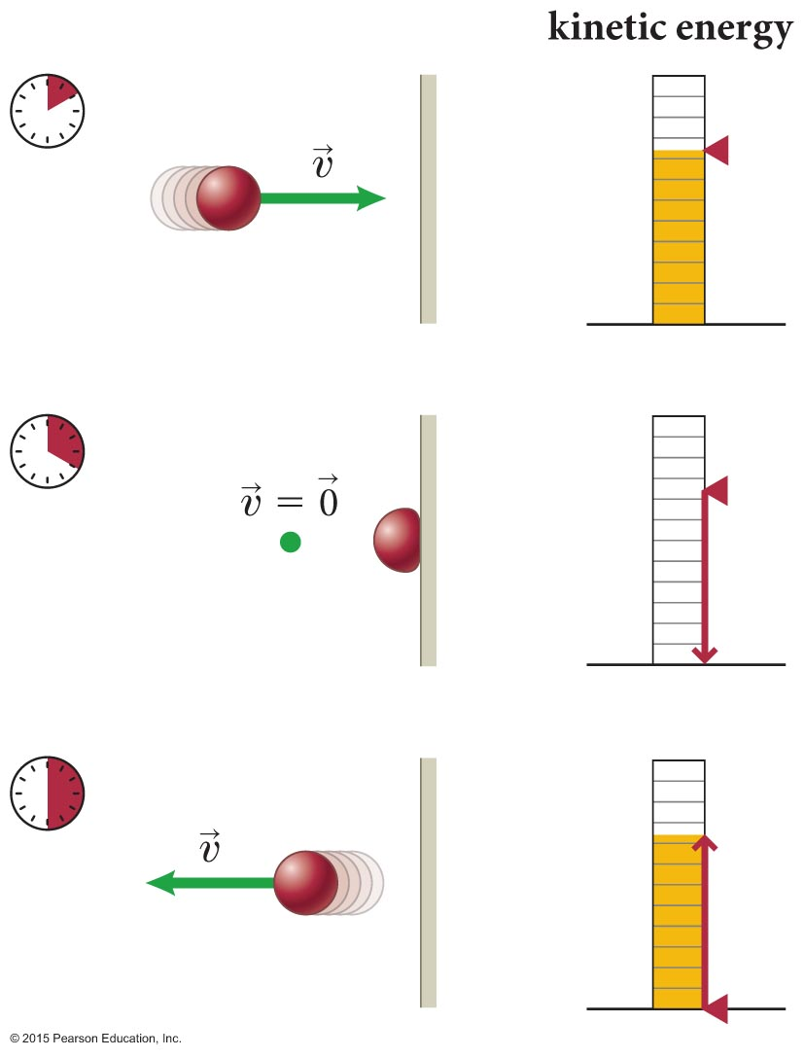
Section 7.1: The effects of interactions
So, does the system violate energy conservation during the interaction?
No: The kinetic energy “missing” during the interaction has merely been temporarily converted to internal energy.
As seen in the figure, the kinetic energy of the bouncing ball goes into changing the shape of the ball during the interaction with the wall.
As the ball regains its original shape, the kinetic energy that was converted to internal energy reappears as kinetic energy after the collision.
© 2015 Pearson Education, Inc.

Slide 10
Section 7.1: The effects of interactions
We can summarize the characteristics of an interaction:
Two objects are needed.
The momentum of an isolated system of interacting objects is the same before, during, and after the interaction.
© 2015 Pearson Education, Inc.

Slide 11
Section 7.1: The effects of interactions
In addition, for interactions that affect the motion of objects:
The ratio of the x component of the accelerations of the interacting objects is the negative inverse ratio of their inertias.
The system’s kinetic energy changes during the interaction. Part of it is converted to (or from) some internal energy:
In elastic collisions, all of the converted energy reappears as kinetic energy after the collisions.
In inelastic collisions, some of the converted kinetic energy reappears as kinetic energy.
© 2015 Pearson Education, Inc.

Slide 12
Checkpoint 7.4
(a) In Figure 7.5, what is the momentum of the ball during the collision? (b) Is the momentum of the ball constant before, during, and after the collision? If so, why? If not, why not, and for what system is the momentum constant?
7.4
© 2015 Pearson Education, Inc.

Slide 13
Section 7.2: Potential energy
In any interaction, the part of the converted kinetic energy that is temporarily stored as internal energy and is then converted back to kinetic energy after the transaction is called potential energy (U).
Potential energy is stored in reversible changes in the configuration state of the system or the spatial arrangement of the system’s interacting components.
There are many forms of potential energy related to the way the interacting objects arrange themselves spatially.
© 2015 Pearson Education, Inc.

Slide 14
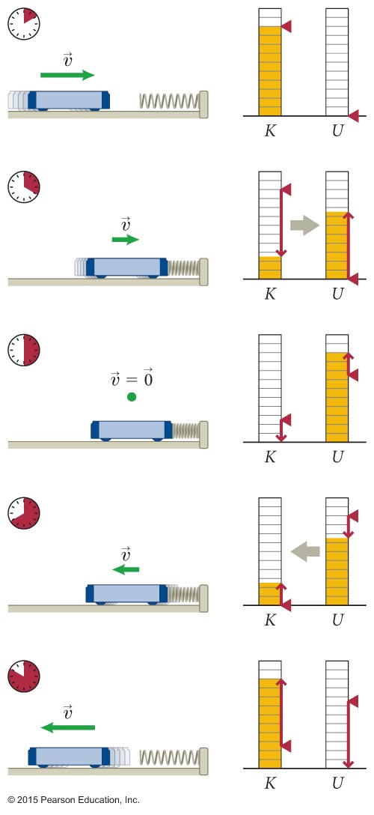
Section 7.2: Potential energy
When you squeeze a ball or a spring, you change the configuration state of the atoms that make up the ball or spring.
Reversible deformation corresponds to changes in elastic potential energy.
As seen in the figure, during the interaction between cart and spring, the kinetic energy is temporarily converted to elastic potential energy in the spring.
© 2015 Pearson Education, Inc.

Slide 15
Section 7.2: Potential energy
If you throw a ball up in the air, you change the configuration state of the ball-Earth system.
As the ball moves upward, the form of potential energy called gravitational potential energy is stored in the system.
As the ball moves back toward the Earth, gravitational potential energy converts back to kinetic energy and the ball speeds up.
Potential energy is the form of internal energy associated with reversible changes in the configuration state of an object or system. Potential energy can be converted entirely to kinetic energy.
© 2015 Pearson Education, Inc.

Slide 16
Exercise 7.2 Launch
Section 7.2: Potential energy
A ball is pressed down on a spring and then released from rest. The spring launches the ball upward. Identify the energy conversions that occur between the instant the ball is released and the instant it reaches the highest point of its trajectory.
© 2015 Pearson Education, Inc.

Slide 17
Exercise 7.2 Launch (cont.)
Section 7.2: Potential energy
SOLUTION As the spring expands, elastic potential energy stored in the spring is converted to kinetic energy of the ball. As the ball travels upward, it slows down and the kinetic energy is converted to gravitational potential energy of the ball-Earth system.✔
© 2015 Pearson Education, Inc.

Slide 18
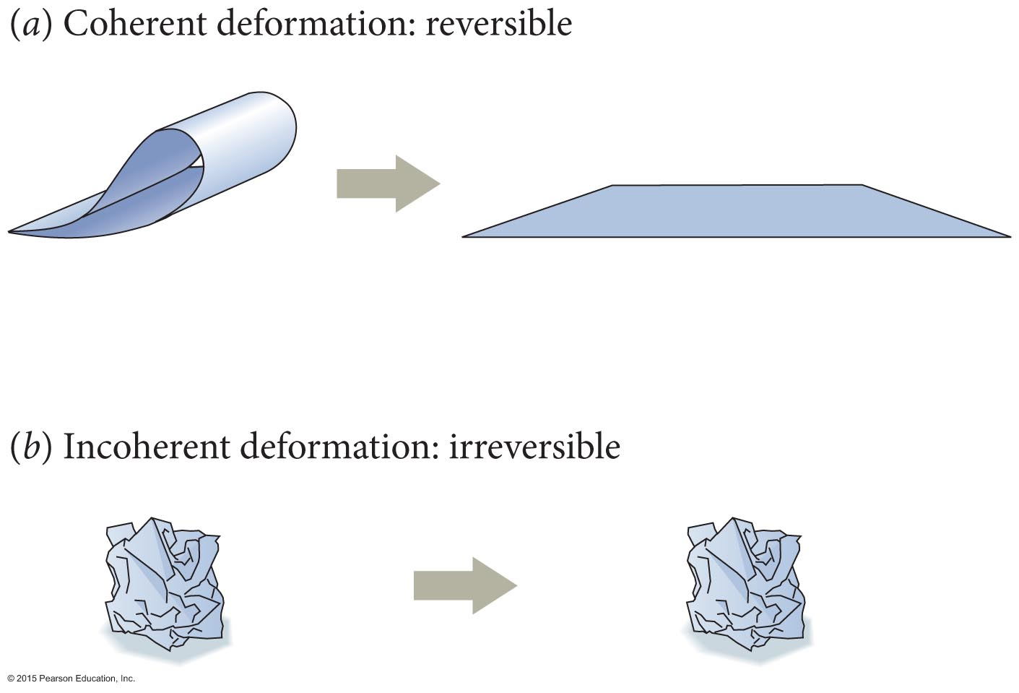
Section 7.3: Energy dissipation
Part of the converted kinetic energy that does not reappear after an inelastic collision is said to be dissipated.
To illustrate the idea of energy dissipation, consider the example shown below:
Coherent deformation (reversible): A piece of paper that is gently bent returns spontaneously to its original shape.
Incoherent deformation (irreversible): If crumpled, it does not regain its original shape.
© 2015 Pearson Education, Inc.

Slide 19
Section 7.3: Energy dissipation
We can now give a complete classification of energy:
The sum of a system’s kinetic energy and potential energy is called the system’s mechanical energy or coherent energy.
A system can also have incoherent energy associated with the incoherent motion and configuration of its parts.
An important part of a system’s incoherent energy is its thermal energy.
The higher the thermal energy of an object, the higher the temperature.
© 2015 Pearson Education, Inc.

Slide 20
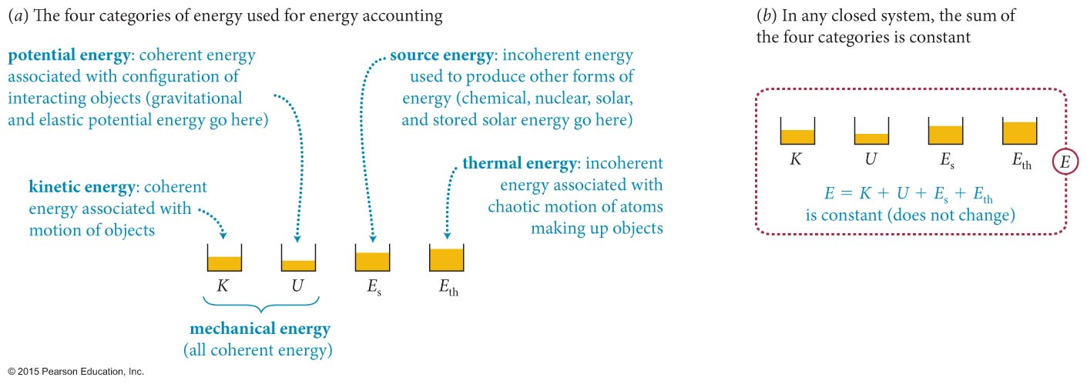
Section 7.4: Source energy
Energy obtained from sources such as fossil fuels, nuclear fuels, biomass fuels, water reservoirs, solar radiation, and wind are collectively called source energy.
Broadly speaking, there are four kinds of source energy: chemical, nuclear, solar, and stored solar energy.
To facilitate our accounting of energy, we divide all energy into four categories: kinetic energy K, potential energy U, source energy E_{s}, and thermal energy E_{th}.
© 2015 Pearson Education, Inc.

Slide 21
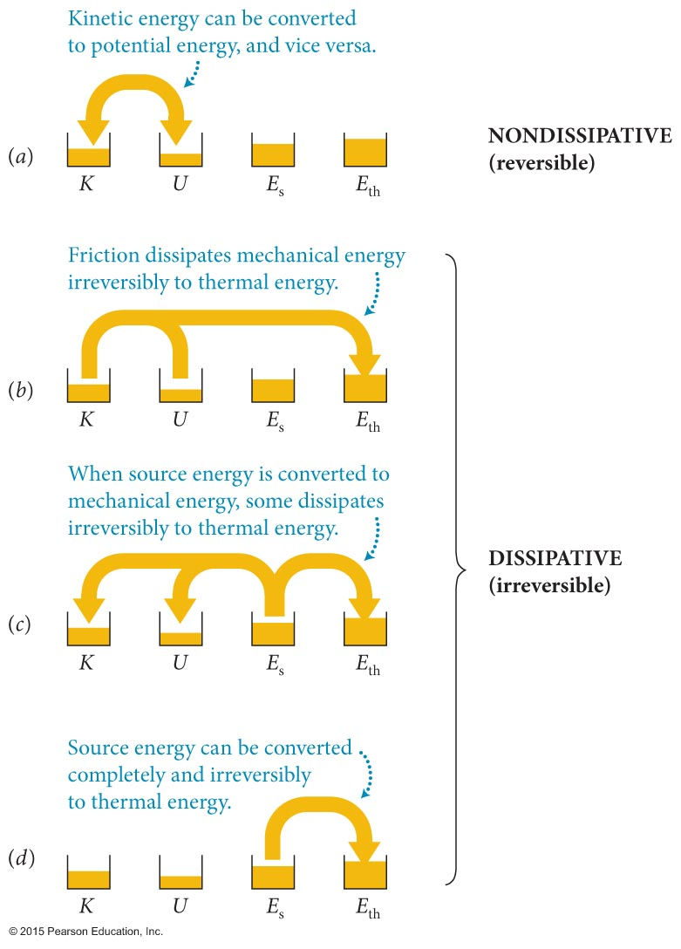
Section 7.4: Source energy
The figure illustrates various types of energy conversions that can occur.
© 2015 Pearson Education, Inc.

Slide 22
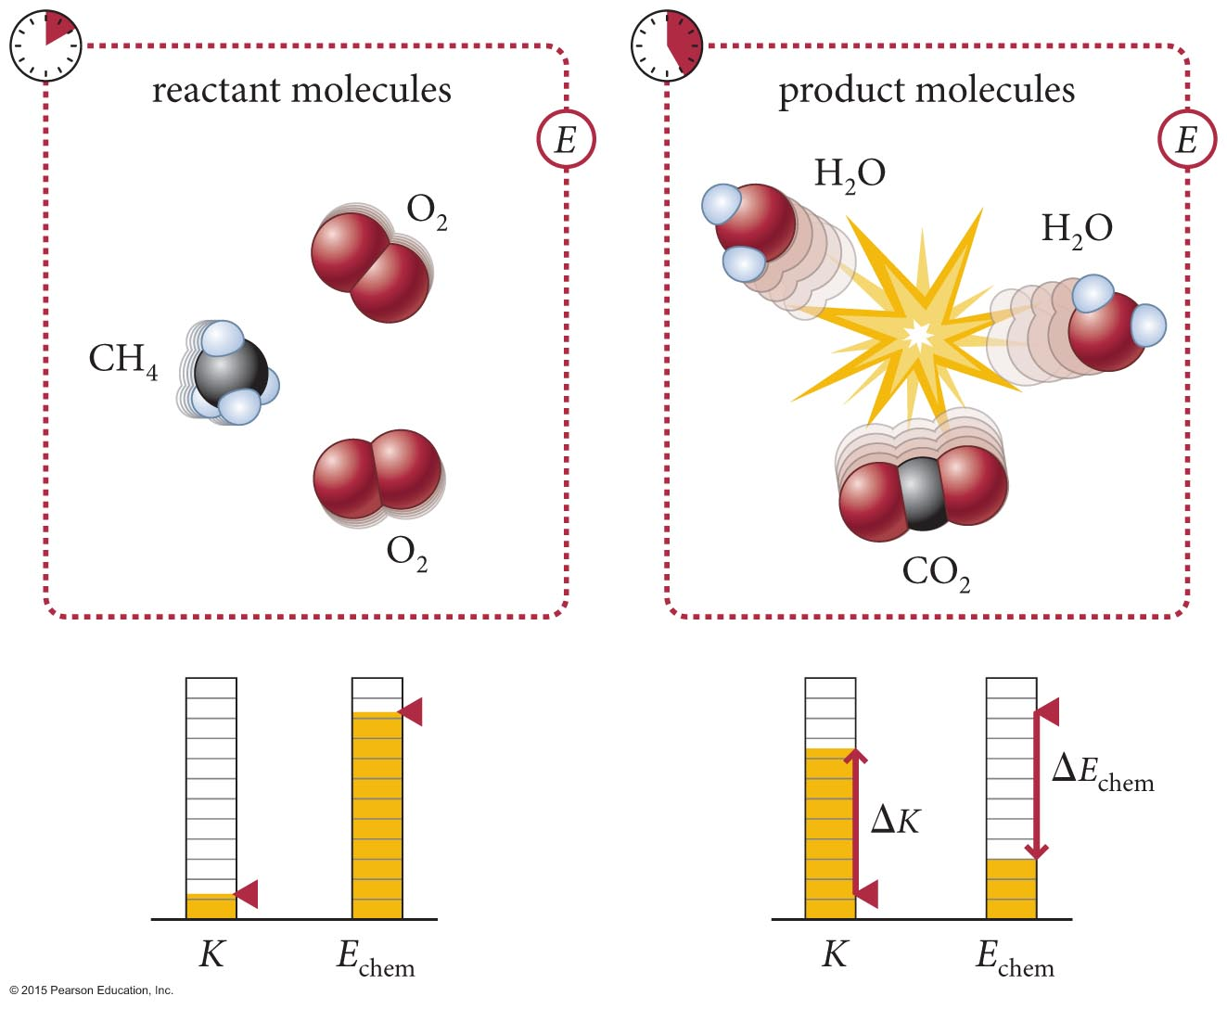
Section 7.4: Source energy
An example of the conversion process shown in part c of the previous slide is illustrated below.
In a combustion of fuels (methane in this case), some chemical source energy is converted to kinetic energy of the reaction products.
© 2015 Pearson Education, Inc.

Slide 23
Section 7.4: Source energy
To determine whether or not an interaction is dissipative, check if the interaction is reversible:
Interactions that cause reversible changes are non-dissipative; those that cause irreversible changes are dissipative.
© 2015 Pearson Education, Inc.

Slide 24
Checkpoint 7.8
Whenever you leave your room, you diligently turn off the lights to “conserve energy.” Your friend tells you that energy is conserved regardless of whether or not your lights are off. Which of you is right?
7.8
© 2015 Pearson Education, Inc.

Slide 25
Exercise 7.3 Converting energy
Section 7.4: Source energy
For each of the following scenarios, choose a closed system, identify the energy conversions that take place, and classify each conversion according to the four processes shown in Figure 7.13. (a) A person lifts a suitcase. (b) A toy suspended from a spring bobs up and down. (c) A pan of water is brought to a boil on a propane burner. (d) A cyclist brakes and comes to a stop.
© 2015 Pearson Education, Inc.

Slide 26
Exercise 7.3 Converting energy (cont.)
Section 7.4: Source energy
SOLUTION (a) Closed system: person, suitcase, and Earth. During the lifting, the potential energy of the Earth-suitcase system increases and the kinetic energy of the suitcase increases. The source energy is supplied by the person doing the lifting, who converts chemical (source) energy from food. In the process of converting this source energy, thermal energy is generated (the person gets hot). This process is represented in Figure 7.13c. ✔
© 2015 Pearson Education, Inc.

Slide 27
Exercise 7.3 Converting energy (cont.)
Section 7.4: Source energy
(b) Closed system: toy, spring, and Earth. As the toy bobs, its height relative to the ground changes, its velocity changes, and the configuration of the spring changes. The bobbing thus involves conversions of gravitational and elastic potential energy and kinetic energy. This reversible process is represented in Figure 7.13a. ✔
© 2015 Pearson Education, Inc.

Slide 28
Exercise 7.3 Converting energy (cont.)
Section 7.4: Source energy
(c) Closed system: pan of water and propane tank. As chemical (source) energy is released by burning the propane, the water is heated and its thermal energy increases. This process is represented in Figure 7.13d.✔
© 2015 Pearson Education, Inc.

Slide 29
Exercise 7.3 Converting energy (cont.)
Section 7.4: Source energy
(d) Closed system: Earth and cyclist. During the braking, the bicycle’s kinetic energy is converted to thermal energy by friction (I’m ignoring the muscle source energy required to pull the brakes). This process is represented in Figure 7.13b.✔
© 2015 Pearson Education, Inc.

Slide 30
Coherent versus incoherent energy
Section 7.4: Source energy
To get a feel for the different types of energy, let’s look at a very ordinary object—a pencil. How many types of energy are (or can be) stored in a pencil?
© 2015 Pearson Education, Inc.

Slide 31
Coherent versus incoherent energy (cont.)
Section 7.4: Source energy
Coherent (mechanical) energy:
Kinetic energy: If the pencil is at rest on your desk, its kinetic energy is zero. If, however, you throw it across the room, you give it a kinetic energy of about 1 J.
Potential energy: To store potential energy in the pencil, you must change its configuration by squeezing or bending it. The pencil, being stiff, does not bend or squeeze easily, and so, if you are lucky, you might be able to store 0.1 J of elastic potential energy in it before it snaps.
© 2015 Pearson Education, Inc.

Slide 32
Coherent versus incoherent energy (cont.)
Section 7.4: Source energy
Incoherent energy:
Thermal energy: Thermal energy is the energy associated with the random jiggling of atoms. It is impossible to convert all of this energy to another form, and so instead let’s imagine you take the pencil out of a drawer and carry it around in your pocket so that its temperature rises from room temperature to body temperature. This rise in temperature increases its thermal energy by 100 J. If you could convert this 100 J of thermal energy to kinetic energy, your pencil would be moving at the speed of an airplane!
© 2015 Pearson Education, Inc.

Slide 33
Coherent versus incoherent energy (cont.)
Section 7.4: Source energy
Incoherent energy:
Chemical energy: Being made of wood, a pencil stores chemical energy, which can easily be released. If you burn the pencil, the wood turns to ashes, and the configuration energy stored in the chemical bonds is converted to thermal energy, which you feel as heat. The energy converted by burning the pencil is 100,000 J, an amount equal to the kinetic energy of a medium-sized car moving at 35 mi/h.
© 2015 Pearson Education, Inc.

Slide 34
Coherent versus incoherent energy (cont.)
Section 7.4: Source energy
Incoherent energy:
Broken chemical bonds: If you bend the pencil enough, it breaks. The energy required to break the chemical bonds in the pencil is about 0.001 J. This amount is only 1% of that 0.1 J of potential energy you added by bending the pencil to just before its breaking point; the remaining 99% ends up as thermal energy: When the pencil snaps, the stress created by the bending is relieved, and the snapping increases the jiggling of the atoms.
© 2015 Pearson Education, Inc.

Slide 35
Coherent versus incoherent energy (cont.)
Section 7.4: Source energy
This comparison of energies makes two important points that are valid more generally. First, coherent forms of energy are insignificant compared with incoherent forms—most of the energy around us is in the form of incoherent energy. Second, when energy is dissipated, virtually all of it becomes thermal energy; the incoherent configuration energy associated with deformation, breaking, and abrasion is generally negligible compared to the energies required to cause these changes.
© 2015 Pearson Education, Inc.

Slide 36
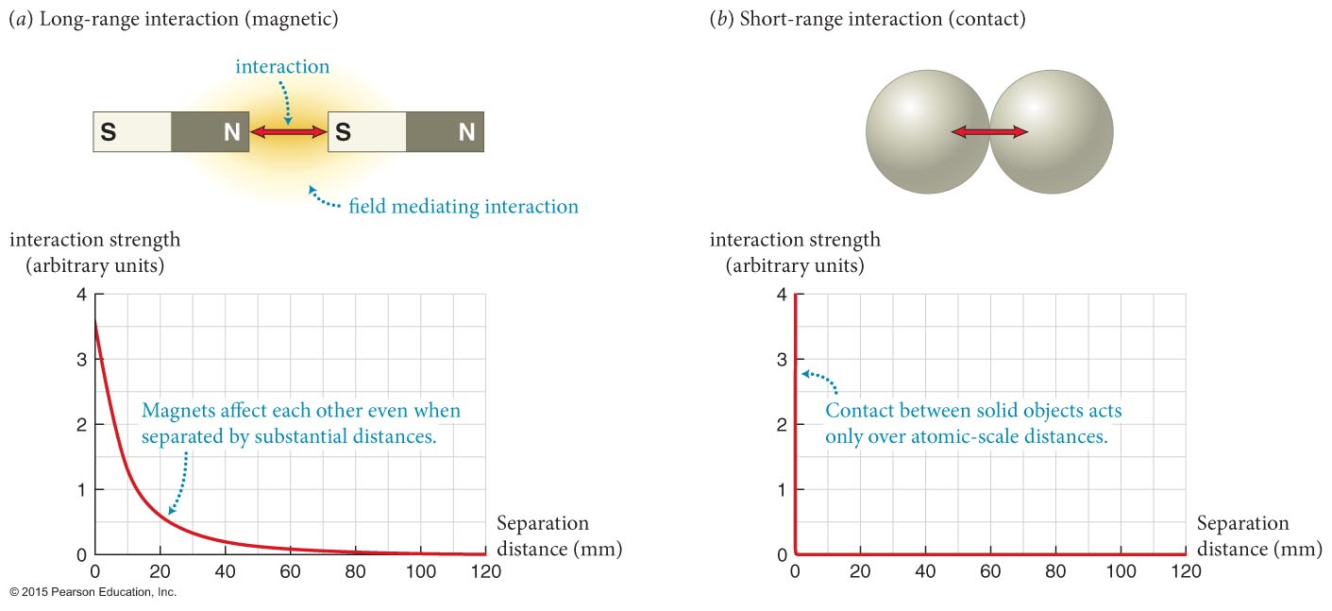
Section 7.5: Interaction range
Matter can be classified according to its interactions.
Attributes we give to various types of matter are a way of indicating the types of interactions they take part in.
The strength of any interaction between two objects is a function of the distance separating them, as illustrated in the figure below.
© 2015 Pearson Education, Inc.

Slide 37
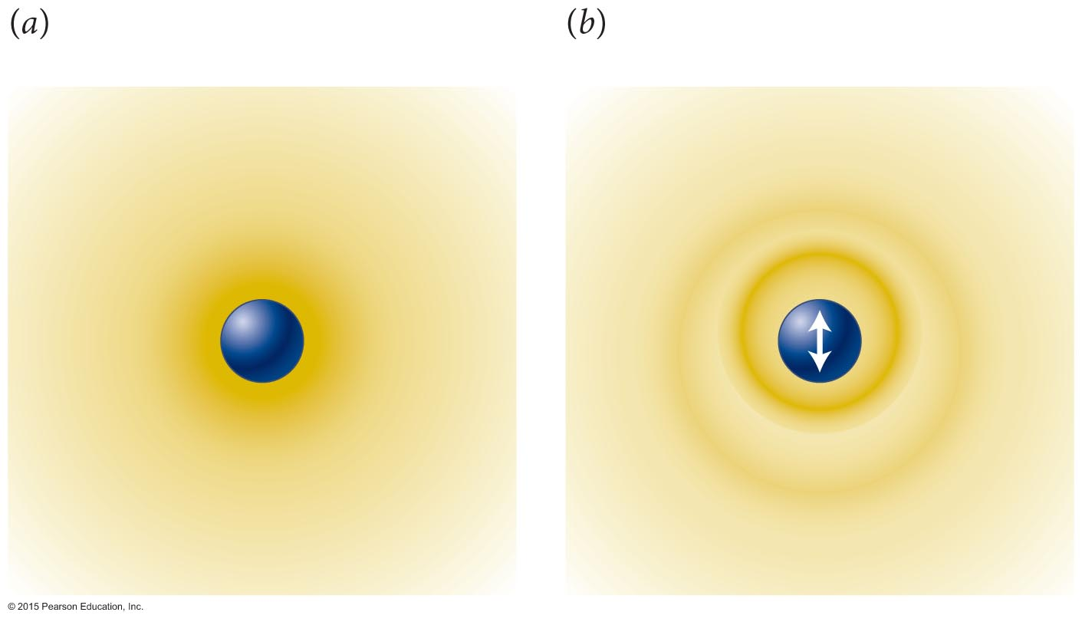
Section 7.5: Interaction range
One model widely used to illustrate long-range interactions is the field, shown in the figure below.
For example, an electrically charged object has an electric field, and interactions are mediated by these fields.
© 2015 Pearson Education, Inc.

Slide 38
Section 7.5: Interaction range
An alternate model explains interactions in terms of an exchange of fundamental particles called gauge particles.
© 2015 Pearson Education, Inc.

Slide 39
Checkpoint 7.10
As an example of an interaction mediated by a “particle,” imagine tossing a ball back and forth with a friend. You are both standing on an icy surface so slippery that friction is negligible. (a) Describe the effect the throwing and catching have on your momentum and your friend’s momentum. (b) Is this an attractive or repulsive interaction? (c) Could you change the interaction into the other type?
7.10
© 2015 Pearson Education, Inc.

Slide 40
Section 7.6: Fundamental interactions
An interaction is fundamental if it cannot be explained in terms of other interactions.
All known interactions can be traced to the four fundamental interactions listed below.
© 2015 Pearson Education, Inc.

Slide 41
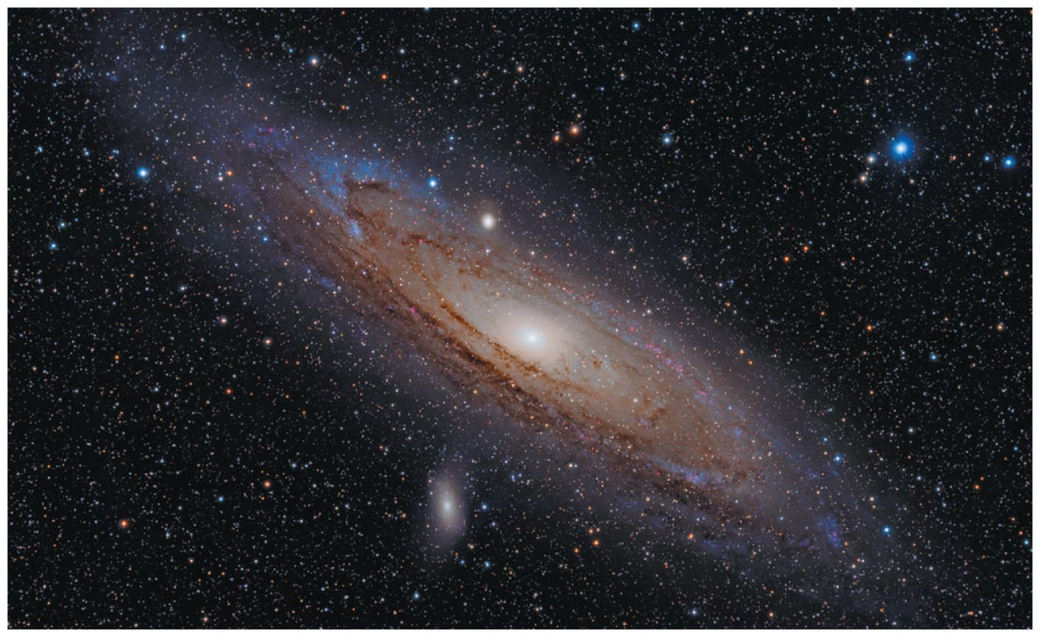
Brief overview of the four fundamental interactions
Section 7.6: Fundamental interactions
Gravitational interaction:
Long-range interaction between all objects that have mass.
Mediated by a gauge particle called the graviton (still undetected).
Determines the large-scale structure of the universe.
© 2015 Pearson Education, Inc.

Slide 42
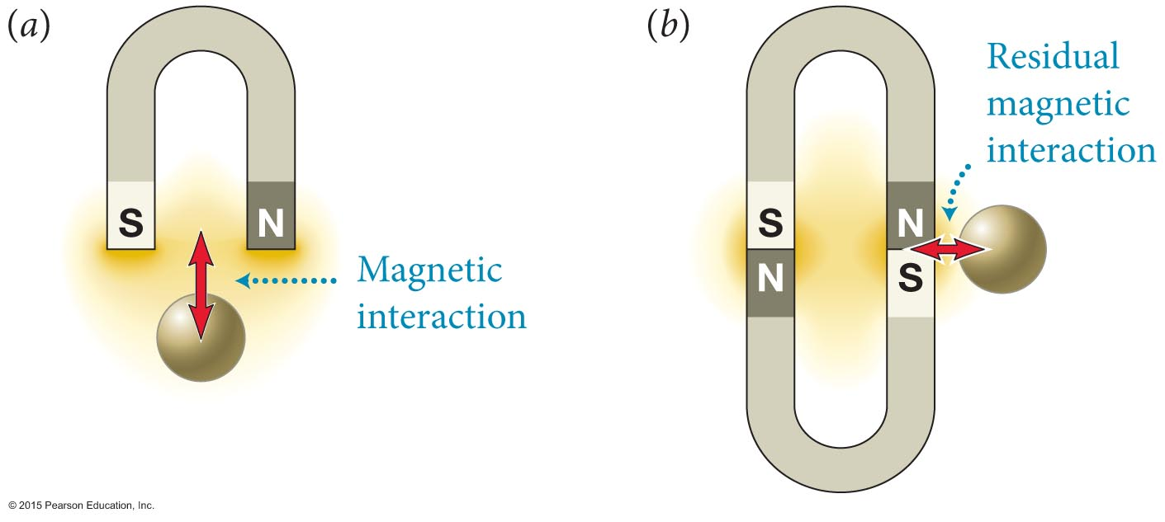
Brief overview of the four fundamental interactions
Section 7.6: Fundamental interactions
Electromagnetic interaction: Responsible for most of what happens around us.
Responsible for the structure of atoms and molecules, for all chemical and biological processes, for repulsive interactions between objects such as a bat and a ball, and for light and other electromagnetic interactions.
Long-range interaction mediated by a gauge particle called the photon.
© 2015 Pearson Education, Inc.

Slide 43
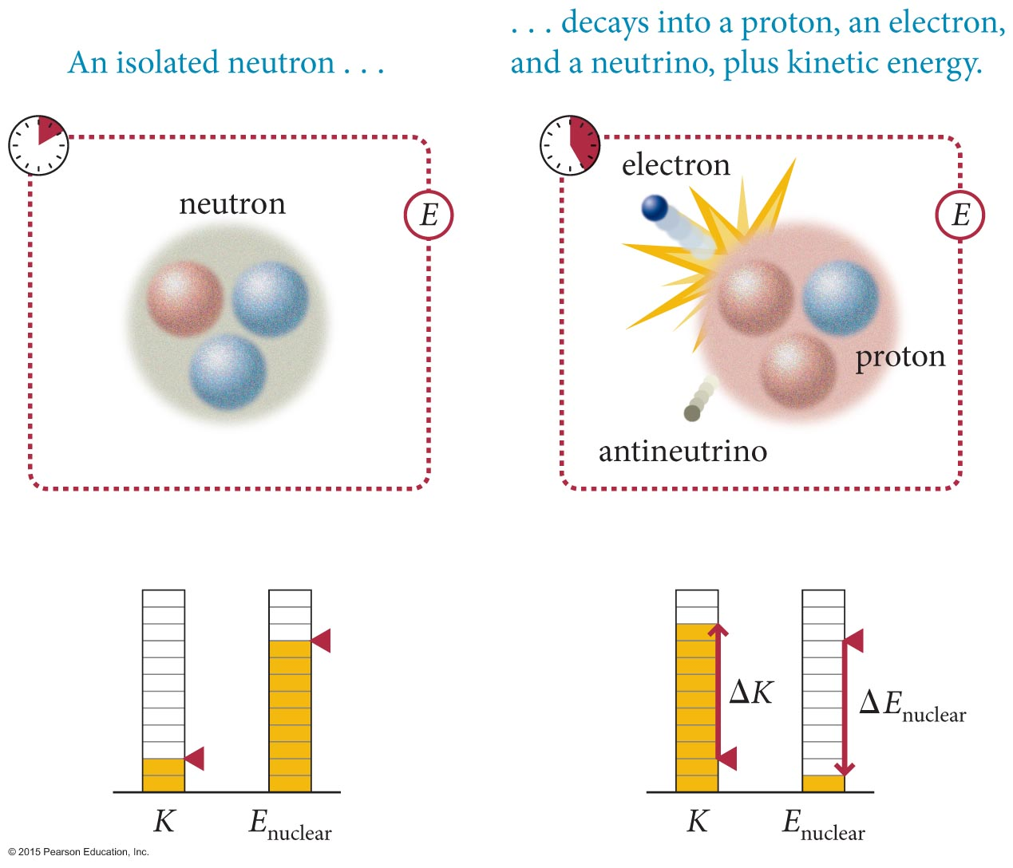
Brief overview of the four fundamental interactions
Section 7.6: Fundamental interactions
Weak interaction: Responsible for some radioactive decay processes and for converting hydrogen to helium in stars.
Acts inside the nucleus of atoms between subatomic particles that carry an attribute called weak charge.
Mediated by gauge particles called vector bosons.
© 2015 Pearson Education, Inc.

Slide 44
Brief overview of the four fundamental interactions
Section 7.6: Fundamental interactions
Strong interaction: Acts between quarks, which are the building blacks of protons and neutrons, and other particles.
The attribute required for this interaction is called color charge.
Mediated by a gauge particles called gluons.
Responsible for holding the nucleus of an atom together.
© 2015 Pearson Education, Inc.

Slide 45
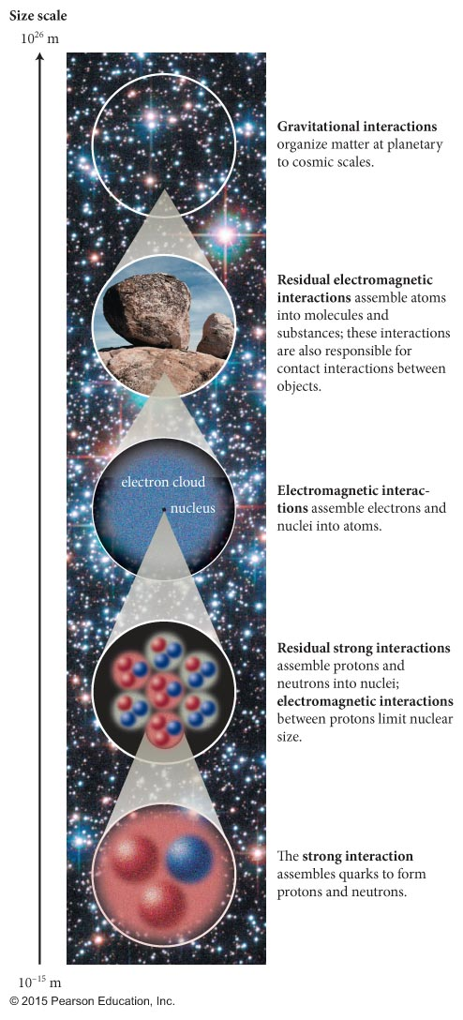
Section 7.6: Fundamental interactions
© 2015 Pearson Education, Inc.

Slide 46
Section 7.7: Interactions and accelerations
Now let us prove the relationship between accelerations and inertia of interacting objects that we saw in section 7.1:
Momentum conservation requires that the momentum of an isolated two-object system remains constant during an interaction:
If the time-interval of the interaction is Δt, then we can write
If the inertias of the two objects are m₁ and m₂, we have
© 2015 Pearson Education, Inc.

Slide 47
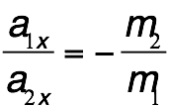
Section 7.7: Interactions and accelerations
Using the definition of acceleration,
We can then rewrite Equation 7.3 as
m₁a_{1x} = –m₂a_{2x}
Rearranging the previous equation, we get
This relationship between the accelerations of two interacting objects of constant inertia holds for all interactions in an isolated two-object system.
© 2015 Pearson Education, Inc.

Slide 48
Checkpoint 7.11
A 1000-kg compact car and a 2000-kg van, each traveling at 25 m/s, collide head-on and remain locked together after the collision, which lasts 0.20 s. (a) According to Eq. 7.6, their accelerations during the collision are unequal. How can this be if both initially have the same speed and the time interval during which the collision takes place is the same amount of time for both? (b) Calculate the average acceleration in the direction of travel experienced by each vehicle during the collision.
7.11
Do this on the board.
© 2015 Pearson Education, Inc.

Slide 49
Section 7.8: Nondissipative interactions
Using the four categories of energy introduced in the previous section, we can write conservation of energy of any closed system as
ΔE = ΔK + ΔU + ΔE_{s} + ΔE_{th} = 0 (closed system)
For nondissipative systems, ΔE_{S} = 0 and ΔE_{th} = 0.
If we introduce mechanical energy of a system as E_{mech} = K + U, we can write
ΔE_{mech} = 0 (closed system, nondissipative interaction)
© 2015 Pearson Education, Inc.

Slide 50
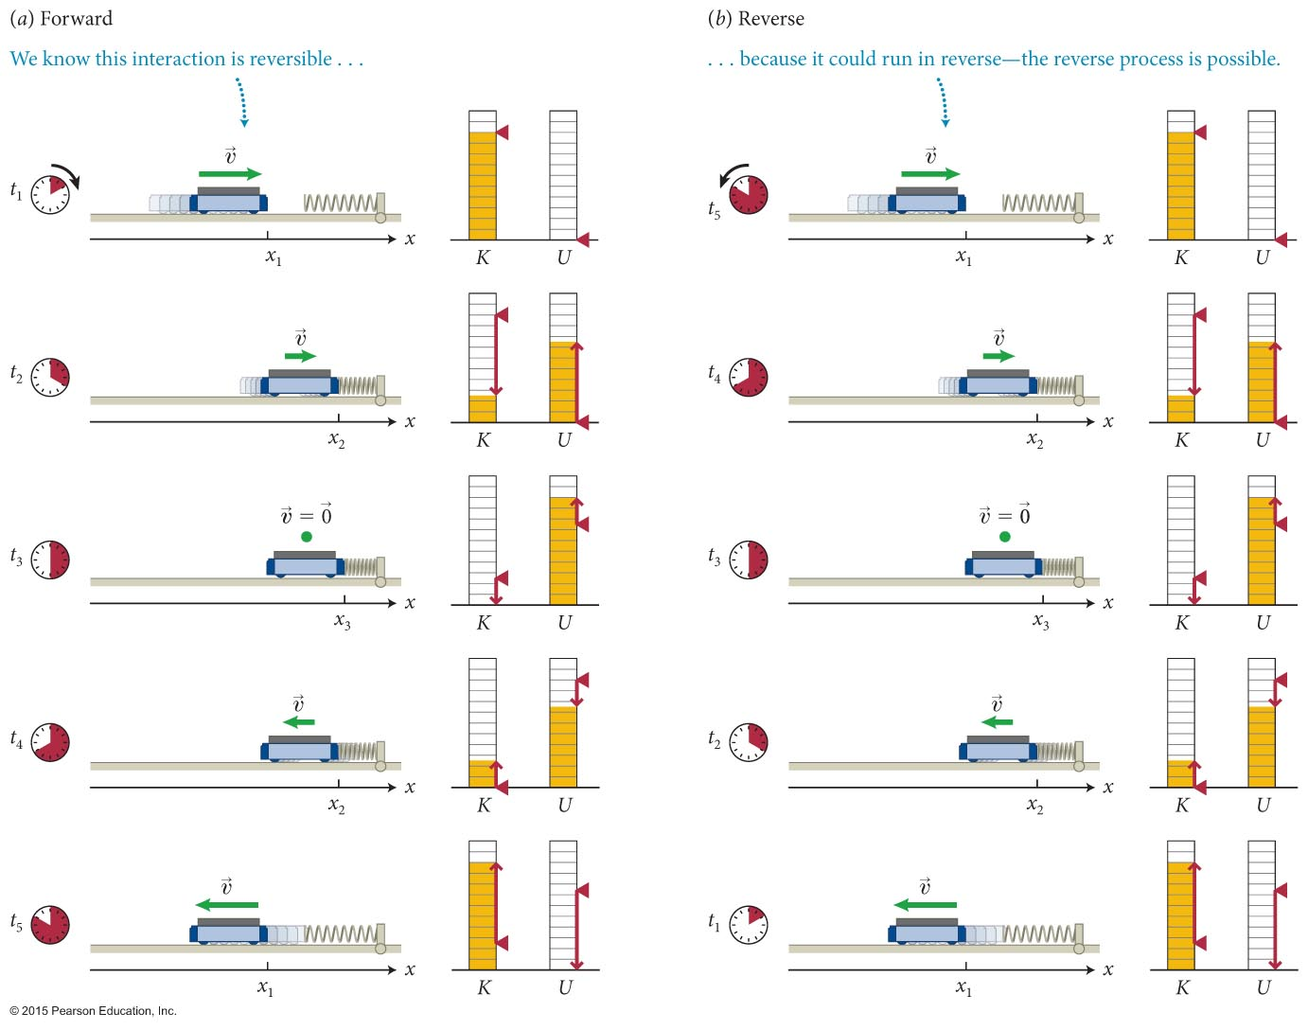
Section 7.8: Nondissipative interactions
Consider the nondissipative interaction shown in the figure below.
© 2015 Pearson Education, Inc.

Slide 51
Section 7.8: Nondissipative interactions
The interaction between the cart and Earth in the previous slide is nondissipative because it is reversible.
Because K_{Earth} does not change, Equation 7.8 yields
ΔK_{cart} = –ΔU_{spring}
where U_{spring} is the elastic potential energy associated with the shape of the spring.
U_{spring} has a definite value at each position x of the end of the spring.
More generally, the potential energy of any system can be written in the form
U = U(x)
© 2015 Pearson Education, Inc.

Slide 52
Checkpoint 7.14
Consider a ball launched upward. Verify that its acceleration points in the direction that lowers the gravitational potential energy of the Earth-ball system.
7.14
© 2015 Pearson Education, Inc.

Slide 53
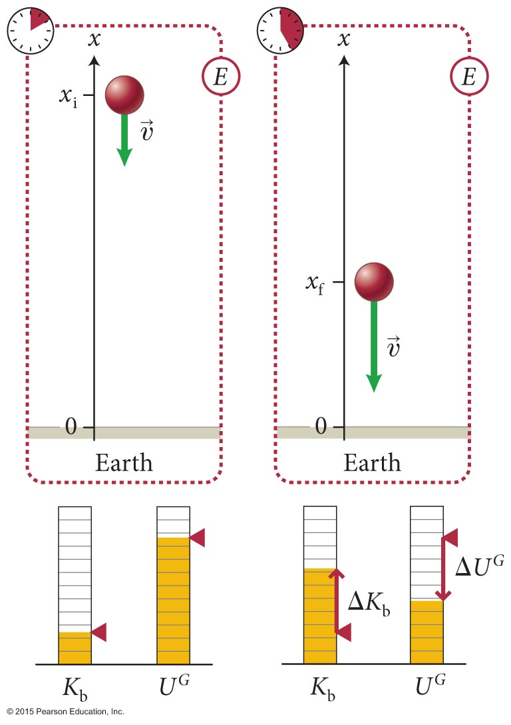
Section 7.9: Potential energy near Earth’s surface
As discussed in Chapter 3, free-falling objects near Earth’s surface fall with an acceleration g = 9.8 m/s².
Since the gravitational interaction near Earth’s surface is nondissipative, and since ΔK_{Earth} = 0, we can write energy conservation as
ΔU^{G} + ΔK_{b} = 0
where ΔU^{G} is the change in gravitational potential energy of Earth-ball system, and ΔK_{b} is the change in the ball’s kinetic energy.
© 2015 Pearson Education, Inc.

Slide 54
Section 7.9: Potential energy near Earth’s surface
We can write the acceleration of the free-falling object as
Substituting a_{x}= – g in Equation 3.7, we can write
Substituting Δt = –Δυ_{x}/g in the previous equation and expanding the Δ notations, along with some algebraic manipulations, gives us
© 2015 Pearson Education, Inc.

Slide 55
Section 7.9: Potential energy near Earth’s surface
Some algebraic manipulations of previous equation gives
The second term above is ΔK_{b}, and so from the energy conservation law, the first term must be ΔU^{G}.
Therefore, the change in gravitational potential energy is
ΔU^{G} = mgΔx (near Earth’s surface)
Expanding the Δ notation in previous equation, we get
© 2015 Pearson Education, Inc.

Slide 56
Section 7.9: Potential energy near Earth’s surface
We can conclude that the gravitational potential energy of the Earth-object system near Earth’s surface is
U^{G}(x) = mgx (near Earth’s surface)
© 2015 Pearson Education, Inc.

Slide 57
Chapter 7 Interactions
© 2015 Pearson Education, Inc.

Slide 58
Section 7.9: Potential energy near Earth’s surface
As discussed in Chapter 3, free-falling objects near Earth’s surface fall with an acceleration g = 9.8 m/s².
Since the gravitational interaction near Earth’s surface is nondissipative, and since ΔK_{Earth} = 0, we can write energy conservation as
ΔU^{G} + ΔK_{b} = 0
where ΔU^{G} is the change in gravitational potential energy of Earth-ball system, and ΔK_{b} is the change in the ball’s kinetic energy.
© 2015 Pearson Education, Inc.

Slide 59
Section 7.9: Potential energy near Earth’s surface
We can write the acceleration of the free-falling object as
Substituting a_{x}= – g in Equation 3.7, we can write
Substituting Δt = –Δυ_{x}/g
© 2015 Pearson Education, Inc.

Slide 60
Section 7.9: Potential energy near Earth’s surface
ΔU^{G} + ΔK_{b} = 0
© 2015 Pearson Education, Inc.

Slide 61
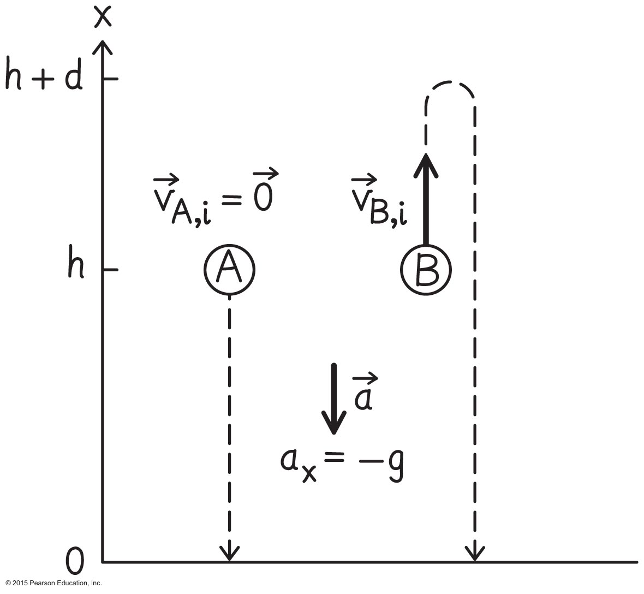
Example 7.5 Path independence of gravitational potential energy
Section 7.9: Potential energy near Earth’s surface
Ball A is released from rest at a height h above the ground. Ball B is launched upward from the same height at initial speed υ_{B,i}. The two balls have the same inertia m.
(a) Using kinematics, show that the change in kinetic energy is the same for both balls.
© 2015 Pearson Education, Inc.

Slide 62
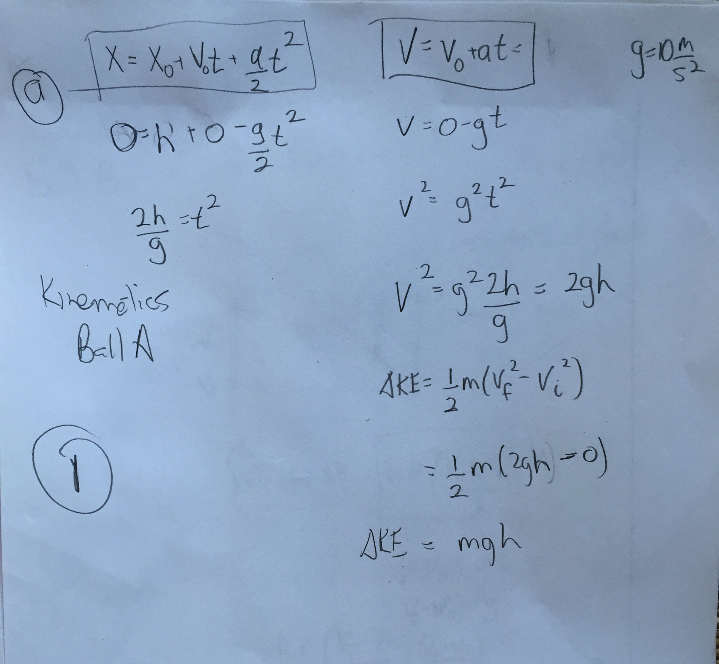
Example 7.5 Path independence of gravitational potential energy
Section 7.9: Potential energy near Earth’s surface
© 2015 Pearson Education, Inc.

Slide 63
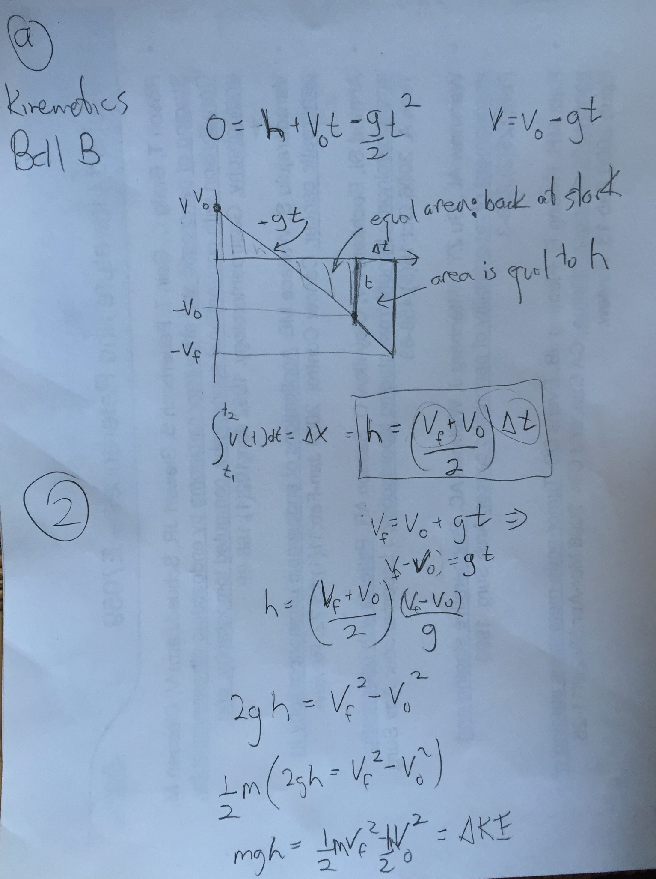
Example 7.5 Path independence of gravitational potential energy
Section 7.9: Potential energy near Earth’s surface
© 2015 Pearson Education, Inc.

Slide 64
Example 7.5 Path independence of gravitational potential energy
Section 7.9: Potential energy near Earth’s surface
© 2015 Pearson Education, Inc.

Slide 65
Section 7.10: Dissipative interactions
An example of a dissipative interaction is shown below:
Dissipative interactions are irreversible.
There is a change in thermal energy in dissipative interactions.
© 2015 Pearson Education, Inc.

Slide 66
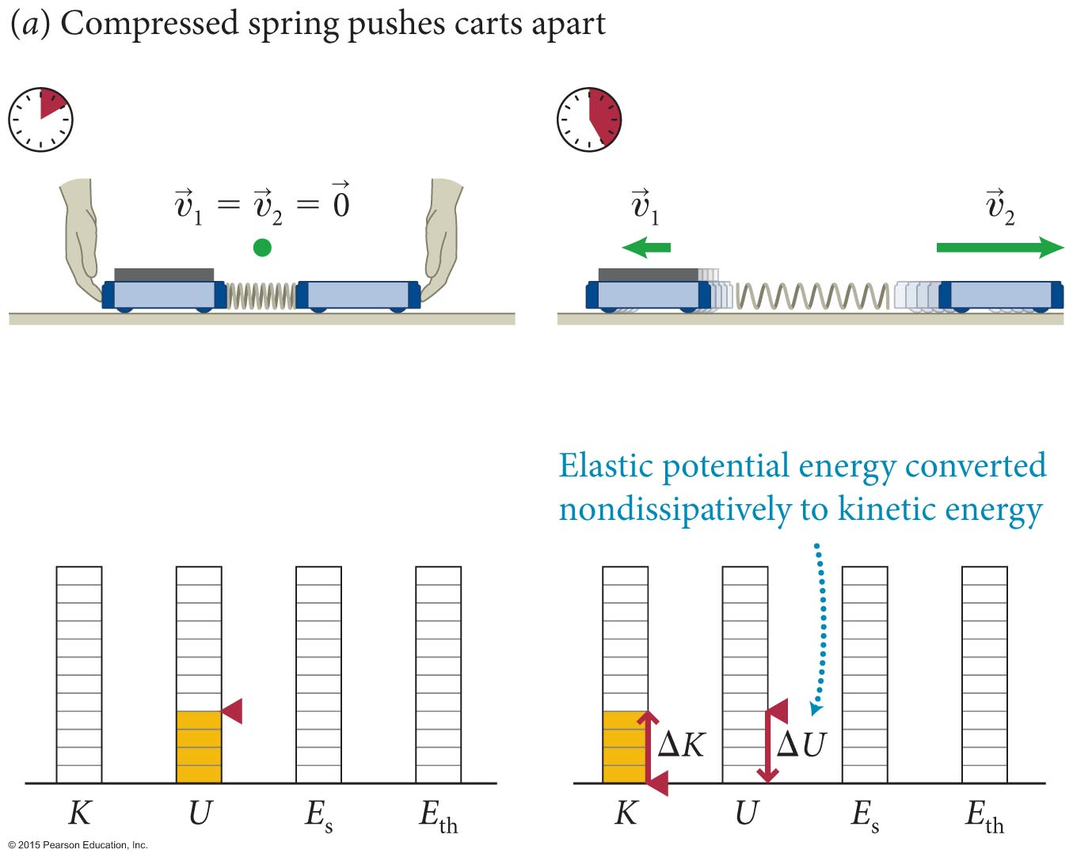
Section 7.10: Dissipative interactions
The figure below shows an explosive separation.
The interaction is reversible because one form of coherent energy (elastic potential energy) is converted to another form of coherent energy (kinetic energy).
This type of nondissipative explosive separation is described by ∆K + ∆U = 0.
Is momentum conserved?
Yes
© 2015 Pearson Education, Inc.

Slide 67
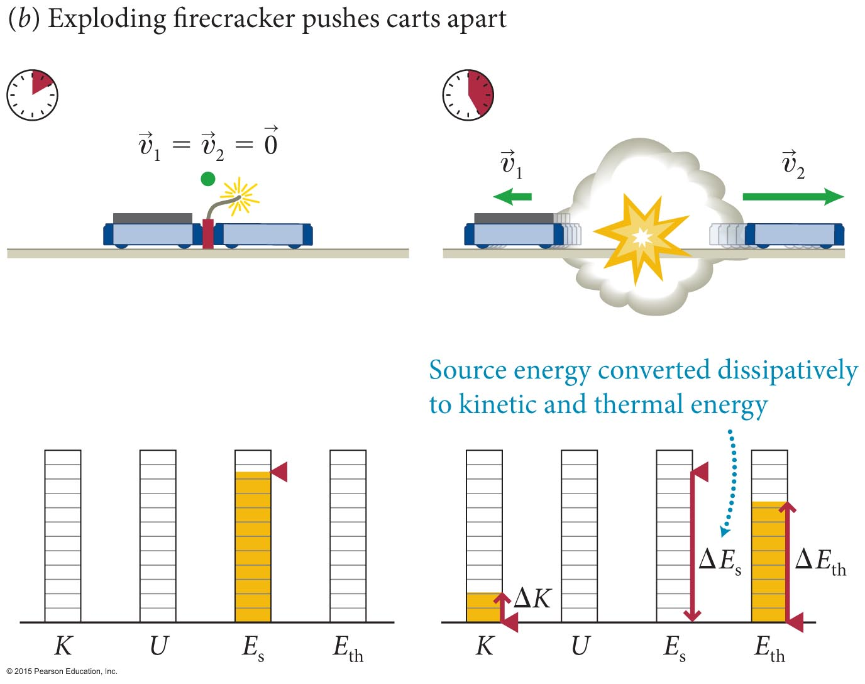
Section 7.10: Dissipative interactions
The interaction shown is an irreversible explosive separation.
During the separation, stored chemical energy in the firecracker is partly converted to (coherent) kinetic energy and partly to (dissipative) thermal energy.
For this interaction, we get
∆K + ∆E_{chem} + ∆E_{th} = 0
https://app.perusall.com/annotation/RAf6Jd3NmsKjZBA2t
© 2015 Pearson Education, Inc.

Slide 68
Perusall
https://app.perusall.com/annotation/ue2ohDaYfTsmcYiTK
https://app.perusall.com/annotation/5aj9ZrkJuXDFNTu7d
https://app.perusall.com/annotation/y6vhwijMATYMcswW2
https://app.perusall.com/annotation/RAf6Jd3NmsKjZBA2t

Slide 69
Chapter 7: Perusall - interactions
https://app.perusall.com/annotation/ue2ohDaYfTsmcYiTK
x(t)
t
v(t)
v₀
t
-v₀
δt
A
a(t)
-g
t

Slide 70
Concepts: The basics of interactions
Chapter 7: Summary
An interaction is an event that produces either a physical change or a change in motion. A repulsive interaction causes the interacting objects to accelerate away from each other, and an attractive interaction causes them to accelerate toward each other.
The interaction range is the distance over which an interaction is appreciable. A long-range interaction has an infinite range; a short-range interaction has a finite range.
© 2015 Pearson Education, Inc.

Slide 71
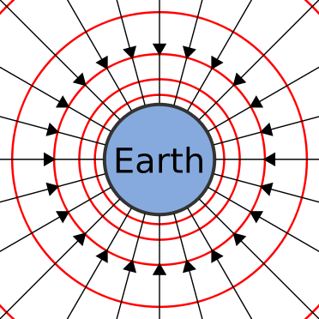
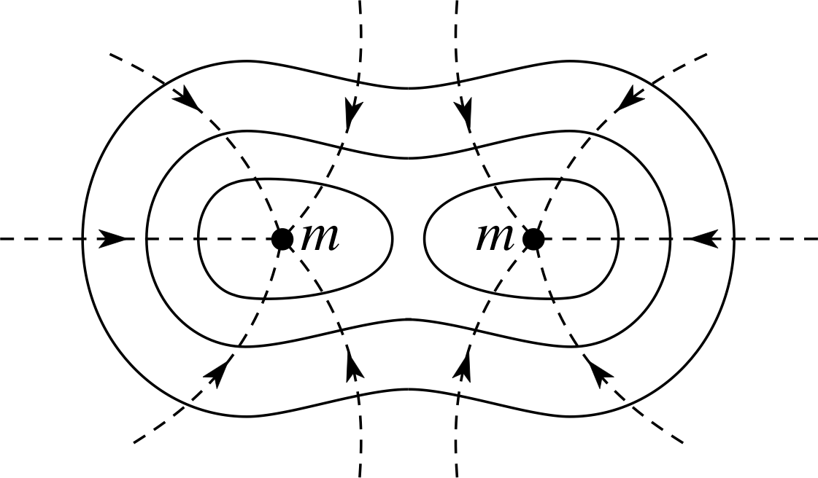
The basics of interactions
Chapter 7: Summary
A field is a model used to visualize interactions between objects. According to this model, each object that takes part in an interaction produces a field in the space surrounding itself, and the fields mediate the interaction between the objects.
© 2015 Pearson Education, Inc.

Slide 72
Concepts: The basics of interactions
Chapter 7: Summary
A fundamental interaction is one that cannot be explained in terms of other interactions. The four known fundamental interactions are
the gravitational interaction (a long-range attractive interaction between objects that have mass), responsible for large scale structure of universe
the electromagnetic interaction (a long-range interaction between objects that have electrical charge; this interaction can be either attractive or repulsive), responsible for all chemistry, materials science …
the weak interaction (a short-range repulsive interaction between subatomic particles), responsible for nuclear decay and
the strong interaction (a short-range interaction between quarks, the building blocks of protons, neutrons, and certain other subatomic particles; this interaction can be either attractive or repulsive).
© 2015 Pearson Education, Inc.

Slide 73
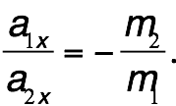
Quantitative Tools: The basics of interactions
Chapter 7: Summary
If two objects of inertias m₁ and m₂ interact, the ratio of the x components of their accelerations is
© 2015 Pearson Education, Inc.

Slide 74
Concepts: Potential energy
Chapter 7: Summary
Potential energy is a coherent form of internal energy associated with reversible changes in the configuration of an object or system. Potential energy can be converted entirely to kinetic energy.
Gravitational potential energy is the potential energy associated with the relative position of objects that are interacting gravitationally.
© 2015 Pearson Education, Inc.

Slide 75
Concepts: Potential energy
Chapter 7: Summary
Elastic potential energy is the potential energy associated with the reversible deformation of objects.
Changes in potential energy are independent of path. This means that the change in an object’s potential energy as the object moves from a position x₁ to any other position x₂ depends only on x₁ and x₂, and not on the path the object takes in moving from x₁ to x₂.
© 2015 Pearson Education, Inc.

Slide 76
Quantitative Tools: Potential energy
Chapter 7: Summary
The potential energy U of a system of two interacting objects can always be written in the form
U = U(x),
where U(x) is a unique function of a position variable x that quantifies the configuration of the system.
Near Earth’s surface, if the vertical coordinate of an object of inertia m changes by Δx, the gravitational potential energy U^{G} of the Earth-object system changes by
ΔU^{G} = mgΔx.
© 2015 Pearson Education, Inc.

Slide 77
Concepts: Energy dissipation during interactions
Chapter 7: Summary
All energy can be divided into two fundamental classes:
Energy associated with motion (kinetic energy) and
Energy associated with the configuration of interacting objects (potential energy).
Each class of energy comes in two forms: coherent and incoherent:
Energy is coherent if it involves ordered motion or configuration; it is incoherent if it involves random motion or configuration. For example, the kinetic energy of a moving object is coherent because all of its atoms move in the same way, whereas the thermal energy of an object is incoherent because the atoms move randomly.
© 2015 Pearson Education, Inc.

Slide 78
Concepts: Energy dissipation during interactions
Chapter 7: Summary
Source energy E_{s} is incoherent energy (such as chemical, nuclear, solar, and stored solar energy) used to produce other forms of energy.
Dissipative interactions are irreversible interactions that involve changes in thermal energy.
Nondissipative interactions are reversible interactions that convert kinetic energy to potential energy, and vice versa.
© 2015 Pearson Education, Inc.

Slide 79
Quantitative Tools: Energy dissipation during interactions
Chapter 7: Summary
E_{mech} = K + U.
During a dissipative interaction, the sum of the changes in all forms of energy in a closed system is zero:
∆E_{mech} + ΔE_{s} + ΔE_{th} = 0.
During a nondissipative interaction, the mechanical energy of a closed system does not change:
∆E_{mech} = ΔK + ΔU = 0.
© 2015 Pearson Education, Inc.

